Slide 1
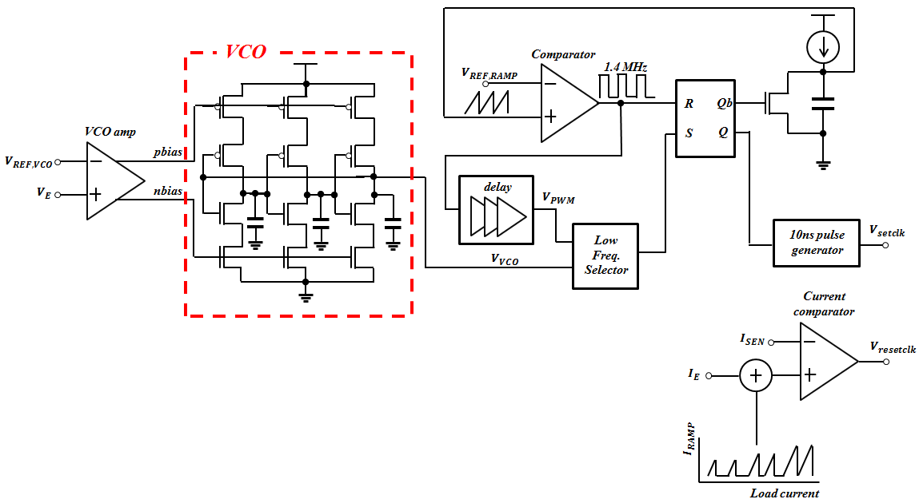
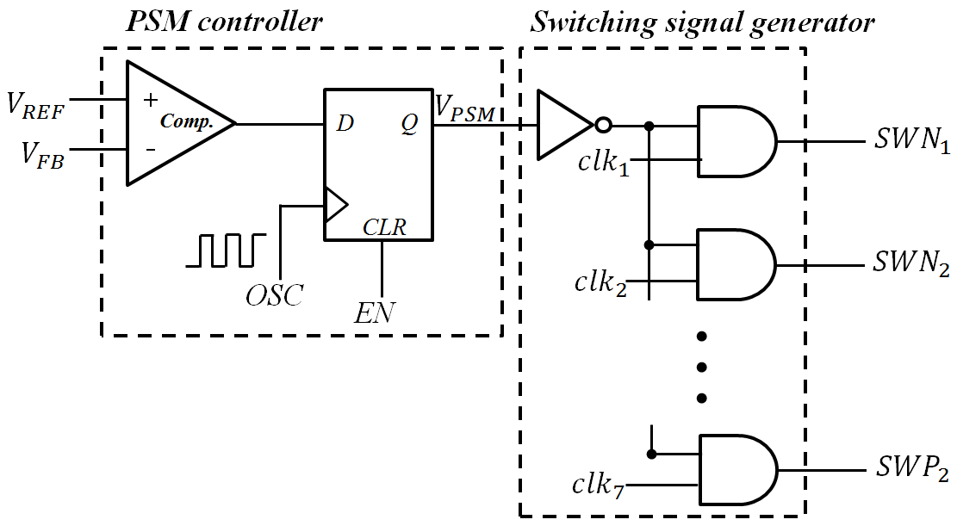
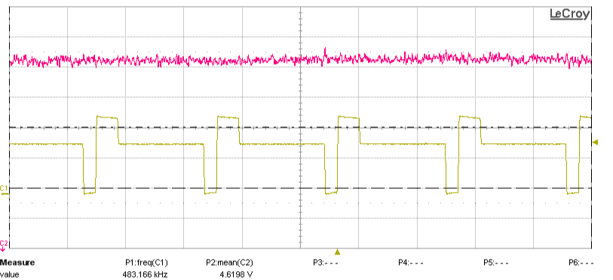
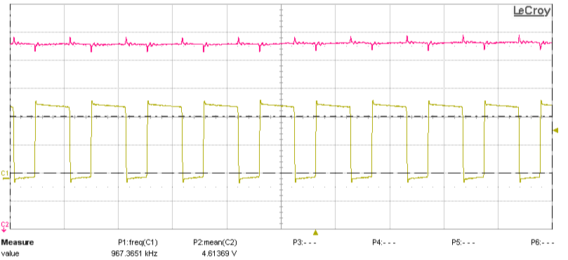
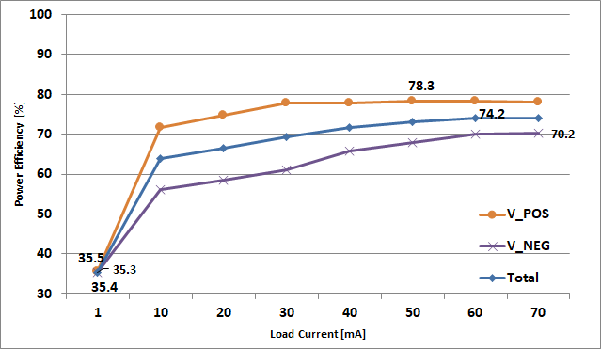
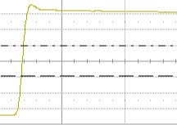
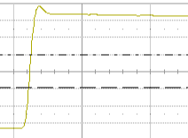






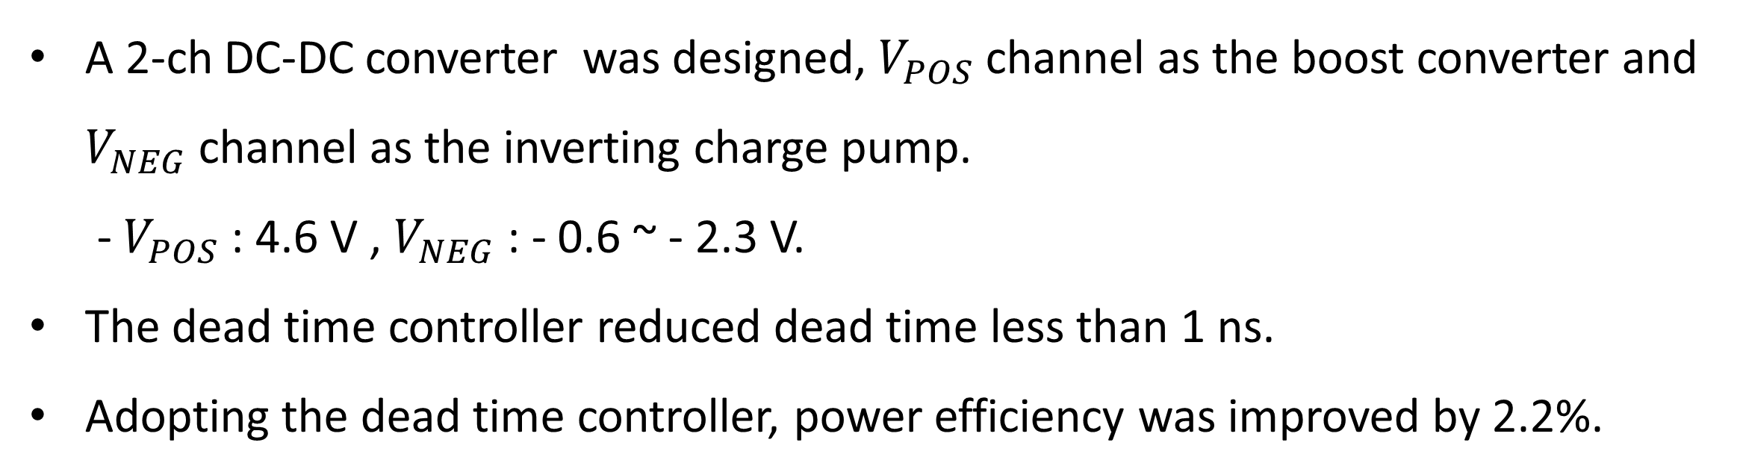




















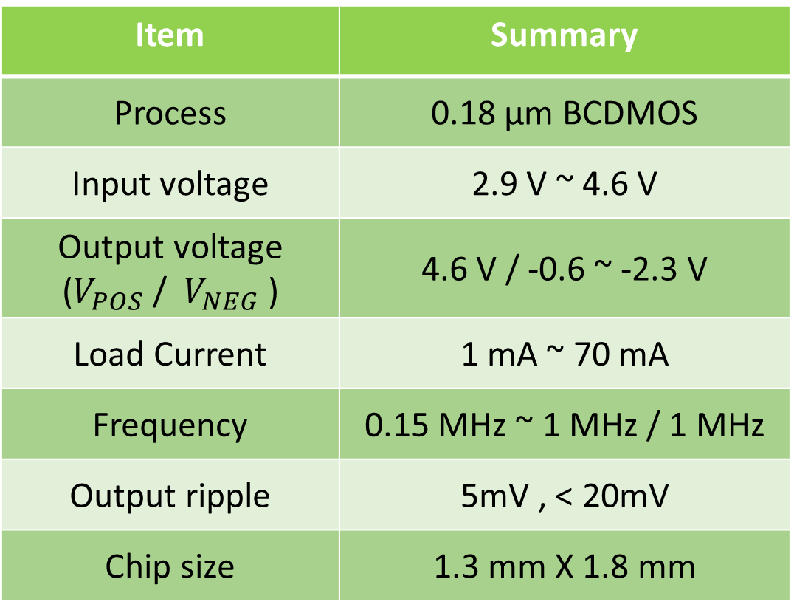




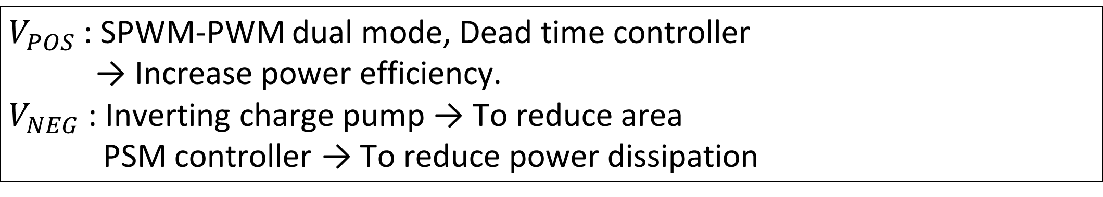


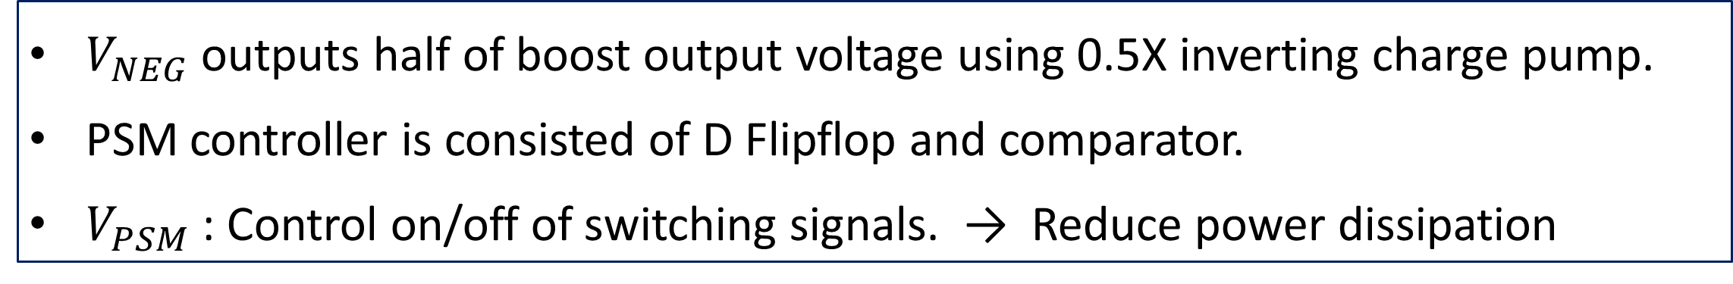




2-Channel DC-DC Converter with Dead Time Controller
for Wearable AMOLED Displays
Tae-Un Kim, Jin-Hui Lee, Seung-Ki Jeon, and Ho-Yong Choi
Department of Semiconductor Engineering, Chungbuk National University
1. Introduction
Light load : set-time variable PWM
: set-time varies in proportion to
load current
Heavy load : PWM
: pulse width varies in proportion to
load current
Adopting AMOLED display in wearable device is rapidly increasing.
Positive and negative voltages are required to drive AMOLED display.
Body-diode conduction loss due to dead time reduces power efficiency.
Fig 3. SPWM-PWM controller.
2.2 ${\text{V}}_{\text{NEG}}$ - Inverting Charge Pump
This paper proposes 2-channel DC-DC converter with a dead time controller for wearable AMOLED display to increase power efficiency.
2. Circuit Design
$$V_{POS}$$
$$V_{NEG}$$
(
$$V_{IN}$$
(Boost Converter)
Inverting
Charge Pump)
Fig 4. 0.5X operation of inverting charge pump.
Fig 5. PSM controller of inverting charge pump.
Zero Current
Detector
$${SW}_{P1}$$
$${SW}_{N1}$$
$${SW}_{P1}$$
$V_{NEG}$ outputs half of boost output voltage using 0.5X inverting charge pump.
PSM controller is consisted of D Flipflop and comparator.
$V_{PSM}$ : Control on/off of switching signals. → Reduce power dissipation
$${SW}_{P2}$$
Gate
$${SW}_{N1}$$
$${SW}_{N2}$$
$$C_{1}$$
Driver
$${SW}_{N3}$$
$${SW}_{P2}$$
Gate Driver
Dead time
Controller
$${SW}_{N4}$$
$${SW}_{N2}$$
GND
$${SW}_{N5}$$
$$V_{REF_NEG}$$
$${SW}_{N3}$$
$$V_{POS}$$
$$v_{setclk}$$
PSM
DIM[2:0]
$$C_{2}$$
$$V_{ERR_POS}$$
-
Controller
DIM
$${SW}_{N4}$$
$${SW}_{N5}$$
Q
S
SPWM
+
Controller
R
Controller
$$V_{REF_POS}$$
GND
3. Results
Current
$$v_{resetclk}$$
Osillartor
Feedback
$$V_{NEG}$$
Sensor
RC
Fig 1. Block diagram of proposed DC-DC converter.
Item | Summary
Process | 0.18 µm BCDMOS
Input voltage | 2.9 V ~ 4.6 V
Output voltage ($V_{POS}$ / $V_{NEG}$ ) | 4.6 V / -0.6 ~ -2.3 V
Load Current | 1 mA ~ 70 mA
Frequency | 0.15 MHz ~ 1 MHz / 1 MHz
Output ripple | 5mV , < 20mV
Chip size | 1.3 mm X 1.8 mm
$V_{POS}$: SPWM-PWM dual mode, Dead time controller
→ Increase power efficiency.
$V_{NEG}$: Inverting charge pump → To reduce area
PSM controller → To reduce power dissipation
2.1. ${\text{V}}_{\text{POS}}$ - Boost Converter
Table 1. Summary of proposed DC-DC converter.
Fig 6. Chip layout.
@ $V_{IN}$ = 3.3 V, $I_{LOAD}$=1 mA
$$V_{POS}$$
@ $V_{IN}$ = 3.3 V, $I_{LOAD}$=70 mA
$$V_{POS}$$
$$V_{LX}$$
(a)
(b)
$$V_{LX}$$
Dead time < 1ns
Dead time < 1ns
Fig 7. Output voltage and dead time of $V_{POS}$ channel.
Fig 8. Power Efficiency.
(c)
(d)
(e)
Dead time is reduced less than 1ns both under light load and heavy load due to dead time controller.
@ $V_{IN}$ = 3.3, $V_{POS}$ = 4.6 V, $V_{NEG}$ = - 2.3 V
Fig 2. (a) Dead time controller, (b) Delay circuit of dead time controller, (c) Switching voltage without dead time controller, (d) Switching voltage with dead time controller, (e) Power efficiency of boost converter
4. Conclusion
$V_{POS}$ channel is implemented using a SPWM-PWM dual mode boost converter.
Dead time controller
- Lx Level Sensor : Generates a pulse if the dead time does not exist.
- UP/DOWN Counter : Counts the pulse generated by Lx level sensor.
- Delay Circuit : Changes RC delay by varying capacitance according to delay [3:0].
→ Due to dead time controller, the dead time is optimized less than 1ns and
power efficiency was increased by 2.2%.
A 2-ch DC-DC converter was designed, $V_{POS}$ channel as the boost converter and $V_{NEG}$ channel as the inverting charge pump.
- $V_{POS}$ : 4.6 V , $V_{NEG}$ : - 0.6 ~ - 2.3 V.
The dead time controller reduced dead time less than 1 ns.
Adopting the dead time controller, power efficiency was improved by 2.2%.
ISD&T
Integrated Systems Design & Test Lab.
The chip fabrication and EDA tool were supported
by the IC Design Education Center(IDEC), Korea.
Chungbuk National University

